Slide 1



Optimizing Hotel Booking Process and Increasing
Revenue through Data Analysis and Visualization

Slide 2
THE
OUTLINE
LIST OF TOPICS
Introduction
Data Analysis
Results and Impact
Conclusion

Slide 3


INTRODUCTION
Project Overview
Objective
Methodology
Tools Used
.

Slide 4

DATA ANALYSIS
Data Manipulation with Python's Pandas Library
Visualization with Power BI Dashboard
Extracting Actionable Insights
Optimization of Hotel Booking Process

Slide 5

RESULTS AND IMPACT
83%
Increased Revenue through Pricing and Marketing Decisions
Enhanced Hotel Booking Process
Improved Project Performance with Python's Pandas Library

Slide 6
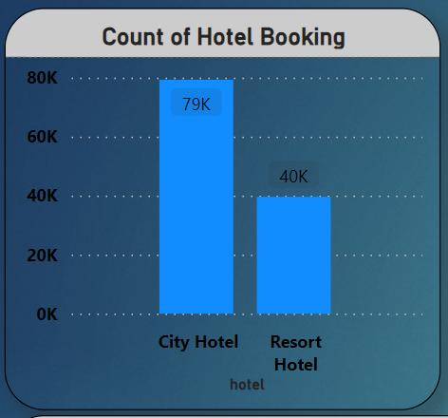

Slide 7
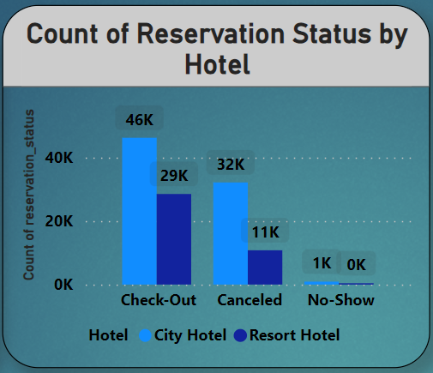

Slide 8
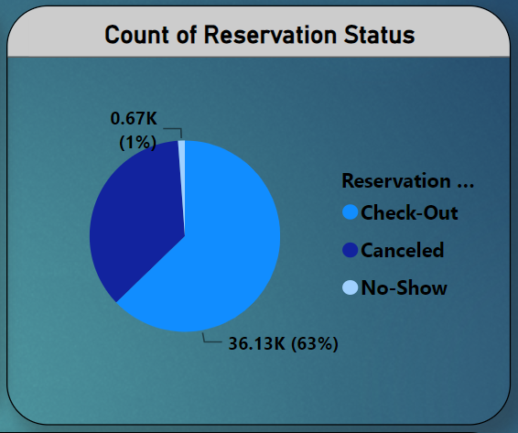

Slide 9
CONCLUSION
Summary of Findings
Key Takeaways

Slide 10
THANK YOU FOR YOUR TIME!

